Slide 1
Logica
Serhat Erdogan

Slide 2
Goals of this lesson
Student knows what is logic about.
Student knows what logical reasoning is and what the relationship with IT is.
Student can think critically.
Student knows basic concepts: what is a definition, induction and deduction, programming and Logical Reasoning.
Student knows what a algorithm is.
Student knows what logical steps to take to make an algorithm.
Student knows what pseudo code is.
Notes:
https://issuu.com/diekeure/docs/vbtl_3-4_ns_logisch_denken_lb_proefversie
https://www.tutorialspoint.com/reasoning/reasoning_analytical_examples.htm
https://www.bbc.co.uk/bitesize/guides/z3bq7ty/revision/1
https://www.bbc.co.uk/bitesize/guides/z8jfyrd/revision/1#glossary

Slide 3
Table of content
What is logica?
What is an algorithm?
What is logic reasoning?
Why use logical reasoning?
Logical reasoning in practice
Comparing algorithms
Designing an algorithm logically

Slide 4
Logic reasoning

Slide 5
Logic
Logic is originally the science concerned with the study of correct reasoning. Already in antiquity(oudheid) it was noted that human reasoning can be systematically broken down into combinations of fixed patterns, so-called inferences. Examples of such inference are:
If you have a headache, you don't like this chocolate. You like this chocolate => so you don't have a headache.
All caimans are reptiles. No reptile can whistle => so no caiman can whistle.
Notes:
logica is van origine de wetenschap die zich bezighoudt met de studie van correct redeneren. Reeds in de oudheid werd opgemerkt dat menselijk redeneren systematisch valt te ontleden in combinaties van vaste patronen, zogenaamde gevolgtrekkingen. Voorbeelden van dergelijke gevolgtrekking zijn:
Als je hoofdpijn hebt, dan lust je deze chocola niet. Je lust deze chocola => dus je hebt geen hoofdpijn.
Alle kaaimannen zijn reptielen. Geen reptiel kan fluiten => Dus geen kaaiman kan fluiten.

Slide 6
What is an algorithm?
A sequence of logical instructions for carrying out a task. In computing, algorithm are needed to design computer programs.
Instruction: A single action that can be preformed by a computer processor.
Let think about some step in the next scenario’s:
Going to the amusement park. Which logical steps do you need to take.
Buying a product from a webshop.
Enrollement of a course.
Notes:
logica is van origine de wetenschap die zich bezighoudt met de studie van correct redeneren. Reeds in de oudheid werd opgemerkt dat menselijk redeneren systematisch valt te ontleden in combinaties van vaste patronen, zogenaamde gevolgtrekkingen. Voorbeelden van dergelijke gevolgtrekking zijn:
Als je hoofdpijn hebt, dan lust je deze chocola niet. Je lust deze chocola => dus je hebt geen hoofdpijn.
Alle kaaimannen zijn reptielen. Geen reptiel kan fluiten => Dus geen kaaiman kan fluiten.

Slide 7
What is logic reasoning?
Logical reasoning is the process of applying rules to problem solving. Algorithms are designed as a set of steps to follow to solve a problem. At the same time, a set of rules is determined. For example, selection is based on rules:
if a condition is met, do this
if not, do that
These rules govern the path that is followed through the algorithm.
Rules are built using logical reasoning to ensure that the algorithm performs correctly.
Notes:
There is almost always more than one solution to a problem. Logical reasoning is used to predict the outcomes of the algorithms that are designed to solve a problem, to help select the best solution.

Slide 8
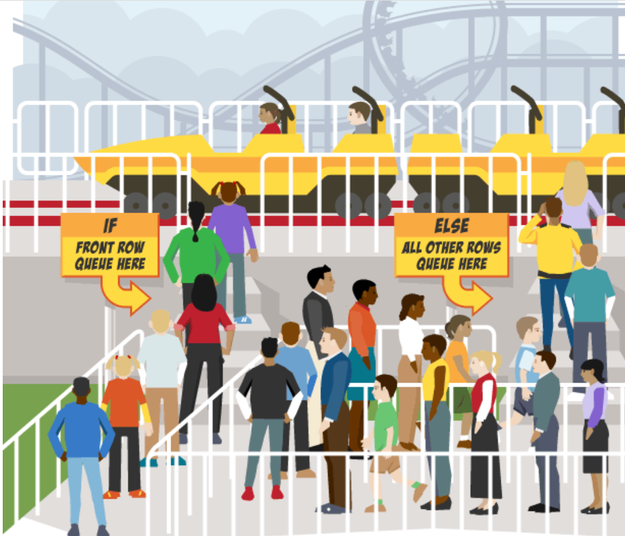
Logic reasoning example

Slide 9
Why use logical reasoning?
Algorithms are step-by-step instructions to solve a problem, created along with rules that decide which path to take when a decision is faced.
When trying to solve a problem, it may be that more than one solution is found. A different algorithm can be built from each solution. Logical reasoning determines if algorithms will work by predicting what happens when the algorithm’s steps - and the rules they consist of - are followed.
Predictions from each algorithm can be used to compare solutions and decide on the best one.

Slide 10
Logica
Logic or reasoning is the part of mathematics that deals with the rules of reasoning. This is about propositional logic: reasoning with propositions. A proposition is a statement that can be true or false.
Example:
Lucas eat a hamburger
Lucas drinkt cola
A proposition can be composed of two or more propositions. It is then connected using conjunctions
Example:
Lucas eat a hamburger and Lucas drinks cola
If Lucas eats a hamburger, then he drinks cola.
Notes:
een propositie kan samengesteld zijn uit twee of meer proposities. Ze is dan verbonden met behulp van voegwoorden

Slide 11
Logical reasoning in practice

Slide 12
Logical reasoning practice
Are you old enough to drive?
Look at this simple pseudocode algorithm for working out if you are old enough to drive a car:
OUTPUT 'How old are you?'
INPUT user inputs their age
STORE the user's input in the age variable
IF age > 17 THEN
OUTPUT 'You are old enough to drive a car!’
ELSE IF age < 17 THEN
OUTPUT 'You are too young to drive a car.’
What did we forget? THINK LOGICALLY ☺
Notes:
This algorithm has a fault.Logical reasoning can be used to determine what the fault is.
There are two conditions in this algorithm. The first checks if age is greater than 17. The second checks if age is less than 17.
We can use logical reasoning to predict the outcomes of this algorithm. Logically, it is clear that a person’s age could be greater than 17, less than 17, or could actually be 17. From this, it is possible to use these values in the algorithm to make predictions:
A rule exists to check if age is greater than 17. If age is greater than 17, the algorithm will output ‘You are old enough to drive a car!’
A rule exists to check if age is less than 17. If age is less than 17, the algorithm will output ‘You are too young to drive a car.’
No rule exists to check if age is equal to 17. If age is equal to 17, there will be no output.
Logic tells us that either a rule needs to be added, or the existing rules need to be changed. The algorithm can be fixed by either:
adding a new rule – ELSE IF age = 17 OUTPUT ‘You are old enough to drive a car!’
or amending the first rule – IF age >= 17 OUTPUT ‘You are old enough to drive a car!’
Either solution would work.

Slide 13
Logical reasoning practice
OUTPUT 'How old are you?'
INPUT user inputs their age
STORE the user's input in the age variable
IF age > 17 THEN
OUTPUT 'You are old enough to drive a car!’
ELSE IF age = 17 THEN
OUTPUT 'You are old enough to drive a car!’
ELSE IF age < 17 THEN
OUTPUT 'You are too young to drive a car.’
Notes:
This algorithm has a fault.Logical reasoning can be used to determine what the fault is.
There are two conditions in this algorithm. The first checks if age is greater than 17. The second checks if age is less than 17.
We can use logical reasoning to predict the outcomes of this algorithm. Logically, it is clear that a person’s age could be greater than 17, less than 17, or could actually be 17. From this, it is possible to use these values in the algorithm to make predictions:
A rule exists to check if age is greater than 17. If age is greater than 17, the algorithm will output ‘You are old enough to drive a car!’
A rule exists to check if age is less than 17. If age is less than 17, the algorithm will output ‘You are too young to drive a car.’
No rule exists to check if age is equal to 17. If age is equal to 17, there will be no output.
Logic tells us that either a rule needs to be added, or the existing rules need to be changed. The algorithm can be fixed by either:
adding a new rule – ELSE IF age = 17 OUTPUT ‘You are old enough to drive a car!’
or amending the first rule – IF age >= 17 OUTPUT ‘You are old enough to drive a car!’
Either solution would work.

Slide 14
Deductive reasoning

Slide 15
Logical deduction
Deductive reasoning is a type of deduction used in science and in life. It is when you take two true statements, or premises, to form a conclusion. For example, A is equal to B. B is also equal to C. Given those two statements, you can conclude A is equal to C using deductive reasoning.
Now, let’s look at a real-life example.
All dolphins are mammals.
All mammals have kidneys.
Using deductive reasoning, you can conclude that all dolphins have kidneys. Remember, for this to work, both statements must be true. Okay, now that you have a good grasp on it, try a few examples.
Notes:
A command or a question can not be a proposition.

Slide 16
Example of deductive reasoning
All numbers ending in 0 or 5 are divisible by 5. The number 35 ends with a 5, so it must be divisible by 5.
All birds have feathers. All robins are birds. Therefore, robins have feathers.
It's dangerous to drive on icy streets. The streets are icy now, so it would be dangerous to drive on the streets.
All cats have a keen sense of smell. Fluffy is a cat, so Fluffy has a keen sense of smell.
Cacti are plants, and all plants perform photosynthesis. Therefore, cacti perform photosynthesis.
Red meat has iron in it, and beef is red meat. Therefore, beef has iron in it.
Acute angles are less than 90 degrees. This angle is 40 degrees, so it must be an acute angle.
All noble gases are stable. Helium is a noble gas, so helium is stable.
Elephants have cells in their bodies, and all cells have DNA. Therefore, elephants have DNA.
All horses have manes. The Arabian is a horse; therefore, Arabians have manes.

Slide 17
Invalid Deductive Reasoning
When it comes to deductive reasoning, you can overgeneralize!!
In these cases, even with two solid and true premises, deductive reasoning goes wrong. Here are a few examples of just that:
All swans are white. Jane is white. Therefore, Jane is a swan.
All farmers like burgers. Jethro likes chicken wings. Therefore, Jethro is not a farmer.
All actors are handsome. Tom Cruise is handsome. Therefore, Tom Cruise is an actor.
In each of these examples, the premises may very well be true, but the conclusions make invalid assumptions. In these examples, a + b does not necessarily equal c. Rather, "c" is an overgeneralization.

Slide 18
Deductive vs. Inductive Reasoning
Inductive Reasoning: The first lipstick I pulled from my bag is red. The second lipstick I pulled from my bag is red. Therefore, all the lipsticks in my bag are red.
Deductive Reasoning: The first lipstick I pulled from my bag is red. All lipsticks in my bag are red. Therefore, the second lipstick I pull from my bag will be red, too.
Inductive Reasoning: My mother is Irish. She has blond hair. Therefore, everyone from Ireland has blond hair.
Deductive Reasoning: My mother is Irish. Everyone from Ireland has blond hair. Therefore, my mother has blond hair.
Inductive Reasoning: Most of our snowstorms come from the north. It's starting to snow. This snowstorm must be coming from the north.
Deductive Reasoning: All of our snowstorms come from the north. It's starting to snow. Therefore, the storm is coming from the north.
Inductive Reasoning: Maximilian is a shelter dog. He is happy. All shelter dogs are happy.
Deductive Reasoning: Maximillian is a shelter dog. All shelter dogs are happy. Therefore, he is happy.
Notes:
The main difference between inductive and deductive reasoning is that inductive reasoning aims at developing a theory while deductive reasoning aims at testing an existing theory.
Inductive reasoning moves from specific observations to broad generalizations, and deductive reasoning the other way around.

Slide 19
Syllogisms
A syllogism exist of three propositions:
Major premise: All men are mortal.
Minor premise: Sacretes is a man.
Conclusion: Sacretes is mortal
If both premises are true then the conclusion will follow, providing the form of the argument is valid.
If the conclusion doesn’t logically follow, we call this “non sequitur”(it does not follow).
Notes:
https://thedecisionlab.com/reference-guide/philosophy/syllogism

Slide 20
Comparing algorithms

Slide 21
Comparing algorithms
Logical reasoning can be used to compare how effective and efficient different solutions are.
Look at this simple pseudocode algorithm for a cinema’s ticketing system. It works out if you are young enough to get a discount:
OUTPUT 'How old are you?'
INPUT User inputs their age
STORE the user's input in the age variable
IF age < 17 THEN
OUTPUT 'You qualify for the student discount!'
ELSE IF age > 17 THEN
OUTPUT 'You're too old for the student discount!'
ELSE IF age = 17 THEN
OUTPUT 'You qualify for the student discount!'
Notes:
There are three conditions in this algorithm. The first checks if age is less than 17. The second checks if age is greater than 17. The third checks if age is equal to 17.
Logically, it is clear that a person’s age could be greater than 17, less than 17 or could actually be 17. From this we use these values in our algorithm to make predictions:
if age is less than 17, the algorithm will output ‘You qualify for the student discount!’
if age is greater than 17, the algorithm will output ‘You’re too old for the student discount!’
if age is equal to 17, the algorithm will output ‘You qualify for the student discount!’
The predictions show that this algorithm will work, because logically all possibilities have been covered.
The following is a different solution:

Slide 22
Different solution
OUTPUT 'How old are you?'
INPUT user inputs their age
STORE the user's input in the age variable
IF age <= 17 THEN
OUTPUT 'You qualify for the student discount!'
ELSE
OUTPUT 'You are too old for the student discount.'
Notes:
There is just one condition in this algorithm. It checks if age is less than or equal to 17.
Logically, it is clear that a person’s age could be greater than 17, less than 17 or could actually be 17. From this we use these values in our algorithm to make predictions:
if age is less than or equal to 17, the algorithm will output ‘You qualify for the student discount!’
otherwise (ie if age is greater than 17) it will output ‘You are too old for the student discount!’
Both algorithms work well. However, if we look at them both we can see that the first algorithm contains three rules (conditions), but the second contains just one.
The second algorithm is shorter, more efficient and easier to program and, therefore, logically would be a better choice.

Slide 23
Quiz
What is logical reasoning?
Counting rules in an algorithm
Using steps to solve problems
Using rules to solve problems
What is logical reasoning used for?
To make decisions
To iterate steps
To predict the outcome of an algorithm
Why is logical reasoning used?
To compare the effectiveness of different algorithms to solve a problem
To count steps in an algorithm
To determine where to start in an algorithm
Notes:
Answer: c, c, a

Slide 24
Quiz
Which symbol means 'greater than'?
>
=
>=
Which symbol means 'greater than or equal to'?
>
=
>=
Which symbol means 'equal to'?
>
=
>=
Notes:
Answer: a, c, b

Slide 25
Quiz
Which condition would confirm that someone 17 or over is able to drive a car?
age = 17
age > 17
age >= 17
Which condition would confirm that someone 12 or over is able to watch a 12 rated film?
age >= 12
age = 12
age > 12
Which condition would confirm that only someone 21 and over can drive a mini-bus?
age >= 21
age > 21
age = 22
Notes:
Answer: c, a, c

Slide 26
Desgning algorithms

Slide 27
Designing an algorithm
An algorithm is a plan, a logical step-by-step process for solving a problem. Algorithms are normally written as a flowchart or in pseudocode.
The key to any problem-solving task is to guide your thought process. The most useful thing to do is keep asking ‘What if we did it this way?’ Exploring different ways of solving a problem can help to find the best way to solve it.
When designing an algorithm, consider if there is more than one way of solving the problem.
Notes:
Before designing an algorithm it is important to first understand what the problem is. Algorithms can be designed using pseudocode or a flowchart, and the standard notations of each should be known.

Slide 28
Designing an algorithm
When designing an algorithm there are two main areas to look at:
The big picture - What is the final goal?
Individual stages – What hurdles need to be overcome on the way to the goal?
Understanding the problem
Before an algorithm can be designed, it is important to check that the problem is completely understood. There are a number of basic things to know in order to really understand the problem:
What are the inputs into the problem?
What will be the outputs of the problem?
In what order do instructions need to be carried out?
What decisions need to be made in the problem?
Are any areas of the problem repeated?
Once these basic things are understood, it is time to design the algorithm.

Slide 29
Pseudocode
Pseudo-code
also written as pseudo-code. A method of writing up a set of instructions for a computer program using plain English. This is a good way of planning a program before coding.
Most programs are developed using programming languages. These languages have specific syntax that must be used so that the program will run properly. Pseudocode is not a programming language, it is a simple way of describing a set of instructions that does not have to use specific syntax.

Slide 30
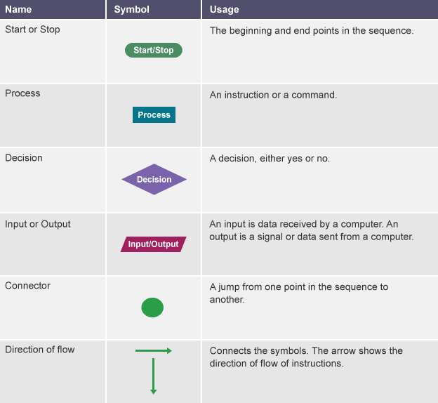
Flowcharts
A flowchart is a diagram that represents a set of instructions. Flowcharts normally use standard symbols to represent the different types of instructions. These symbols are used to construct the flowchart and show the step-by-step solution to the problem.

Slide 31
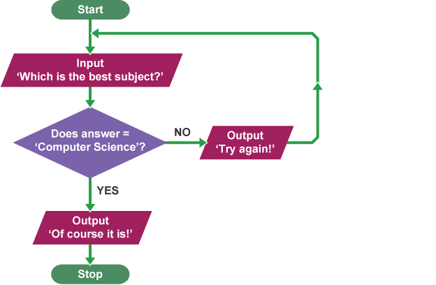
Flowcharts

Slide 32
Building functions

Slide 33
Python excercis
Sum of two numbers
The avg of 3 numbers
Surface of a triangle
Volume of a kubus
Two last numbers:
Input: 793257
Output: 57
Notes:
https://www.w3schools.com/python/python_functions.asp

Slide 34
Functions in python
A function is a block of code which only runs when it is called. You can pass data, known as parameters, into a function.
def my_function():
print("Hello from a function")
my_function()
Notes:
https://www.w3schools.com/python/python_functions.asp

Slide 35
Python excercise
Exercises:
Write 4 functions goLeft(), goRight(), goUp(), goDown(). That print out the direction you going. Write a program that ask the user 1 direction, and uses the functions to print this direction.

